Slide 1


Azure Stream Analytics with Machine Learning
Bala Chirtsabesan
@balachir

Slide 2
Azure Stream Analytics – What and Why?
Azure Stream Analytics is an event-processing engine that allows you to examine high volumes of data streaming from devices.
Lots of data can be streamed from devices, sensors, web sites, social media feeds, applications, and more - Event Producers
Notes:
In today’s world, there’s lots and lots of data that can be streamed from all kinds of devices and applications. Data is valuable only when there is an easy way to process and get timely insights from data sources.
We stream data from different types of devices – IoT devices, social media feeds, applications. These are what we can call Event Producers.
References
What is Azure Stream Analytics?
https://docs.microsoft.com/en-us/azure/stream-analytics/stream-analytics-introduction

Slide 3
Azure Stream Analytics – What and Why?
Analyze the stream of data and derive some intelligence / transform data
Real-time analytics and anomaly detection
Click stream analytics
Do something with analyzed data
Store data to other Azure storage services for further analysis
Send to PowerBI dashboard for real-time visualization
Send to Azure Functions to trigger custom workflows
Notes:
Stream Analytics
Real-time analytics on Point of Sale data for inventory control and anomaly detection
Click stream analytics to understand user behavior and patterns
Typical pipeline using Stream Analytics goes like this – Event Producers produce the data, you use Stream Analytics to analyze the data and then do something with the analyzed data
You can see that there is an additional step in the middle – Event Ingestion

Slide 4
Event Ingestion - Azure Event Hubs
Big data streaming platform and event ingestion service
Unified streaming platform with time retention buffer
Decoupling event producers from event consumers
Why Event Hub?
Support for real-time and batch processing
Scalable : start with data streams in megabytes, and grow to gigabytes or terabytes
Rich ecosystem : process streams in different languages like .NET, Python, Go
Notes:
Before discussing Stream Analytics in more detail, we should know about Event Ingestion and Event Hubs.
Event Hubs – Big data streaming platform and event ingestion service
Event Hubs uses a partitioned consumer model, enabling multiple applications to process the stream concurrently and letting you control the speed of processing.
References
Azure Event Hubs — A big data streaming platform and event ingestion service
https://docs.microsoft.com/en-us/azure/event-hubs/event-hubs-about

Slide 5
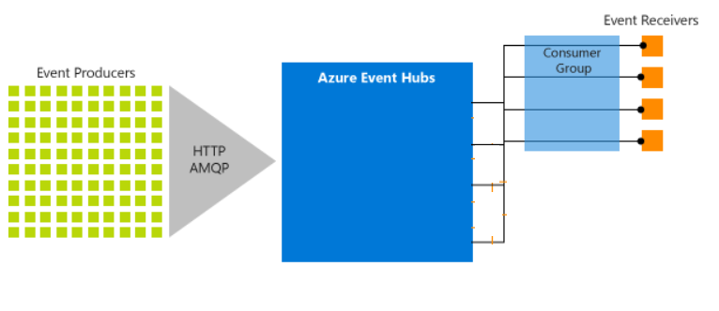
Azure Event Hubs – Simplified Architecture
Notes:
Event producers and event consumers
- Event producers: Any entity that sends data to an event hub. Event publishers can publish events using HTTPS or AMQP 1.0 or Apache Kafka (1.0 and above)
- Event receivers: Any entity that reads event data from an event hub. All Event Hubs consumers connect via the AMQP 1.0 session. The Event Hubs service delivers events through a session as they become available. All Kafka consumers connect via the Kafka protocol 1.0 and later.

Slide 6
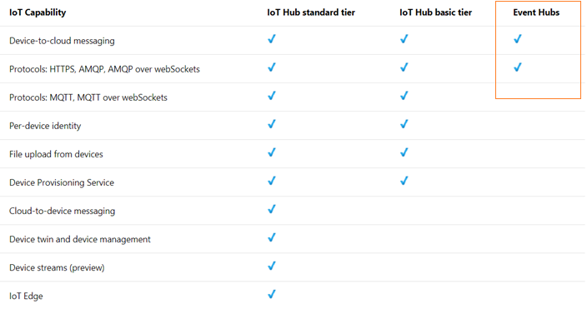
Event Ingestion - Azure IoT Hubs
Deal with stream of telemetry from IoT devices
Like Event Hubs, but lot more capability
Notes:
Lot more capability specific to IoT devices like File upload, per-device identity
References
Connecting IoT Devices to Azure: IoT Hub and Event Hubs https://docs.microsoft.com/en-us/azure/iot-hub/iot-hub-compare-event-hubs

Slide 7
Demo – Analyze phone call data
Generate sample phone call data and send it to Azure Event Hubs
Event Ingestion
Create a Stream Analytics job
Configure job input and output
Define a query to filter fraudulent calls
Test and start the job
Stream Analytics Job
Visualize results in Power BI
Visualize real-time

Slide 8
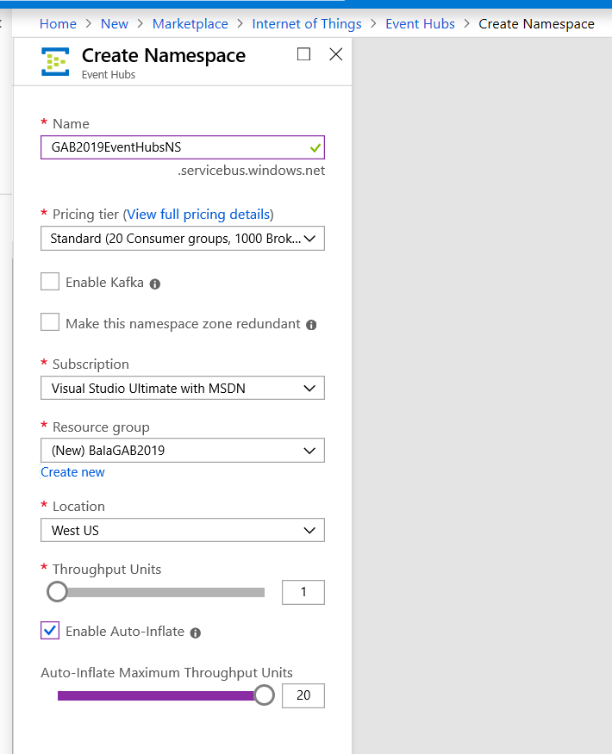
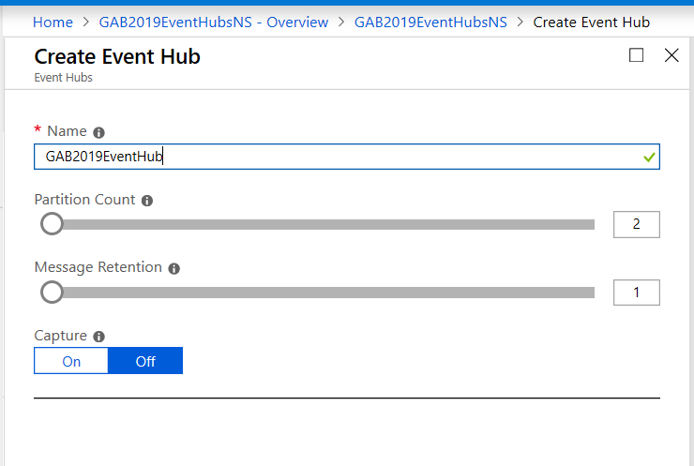
Create EventHub, ingest phone call data

Slide 9
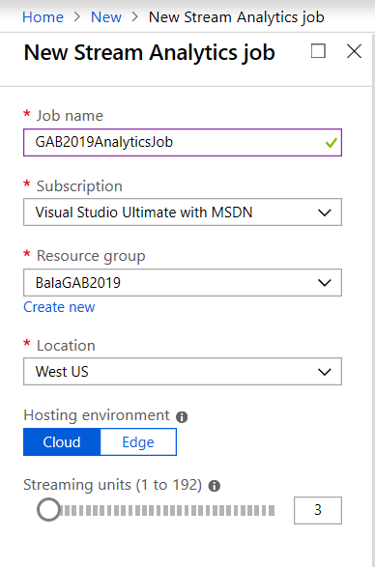
Create Stream Analytics job

Slide 10
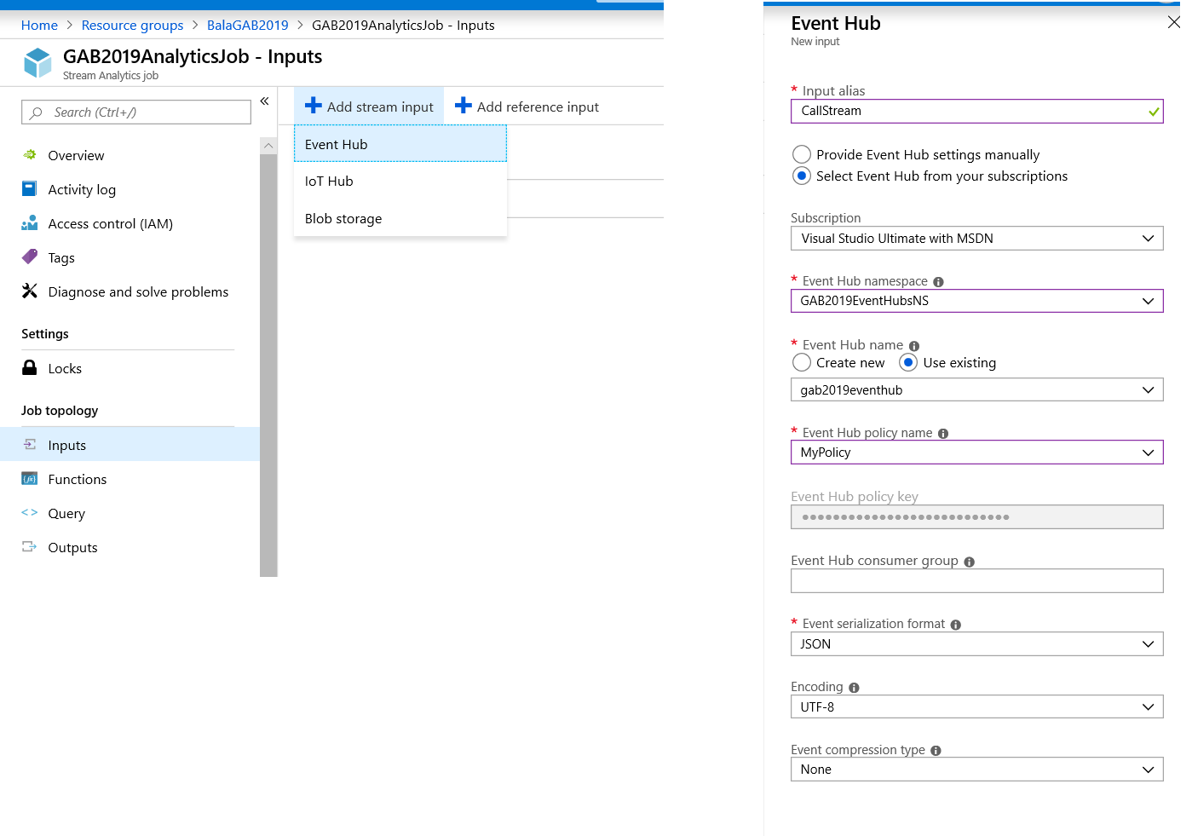
Stream Analytics Job - Input

Slide 11
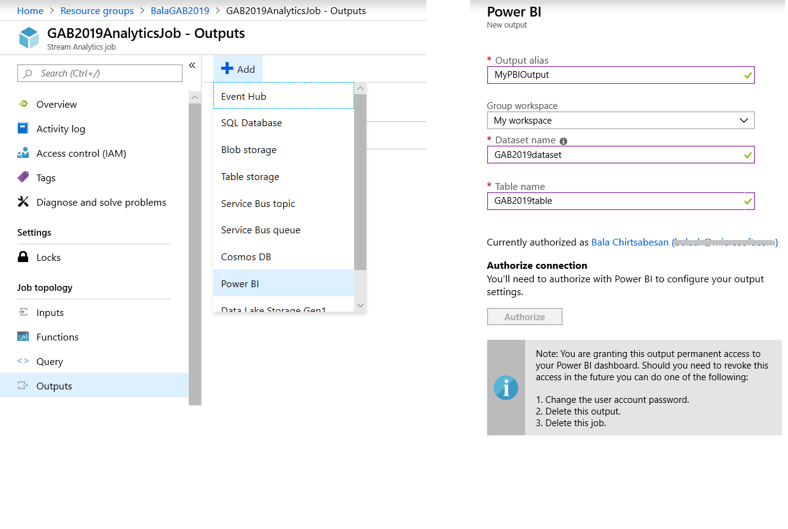
Stream Analytics Job - Output

Slide 12
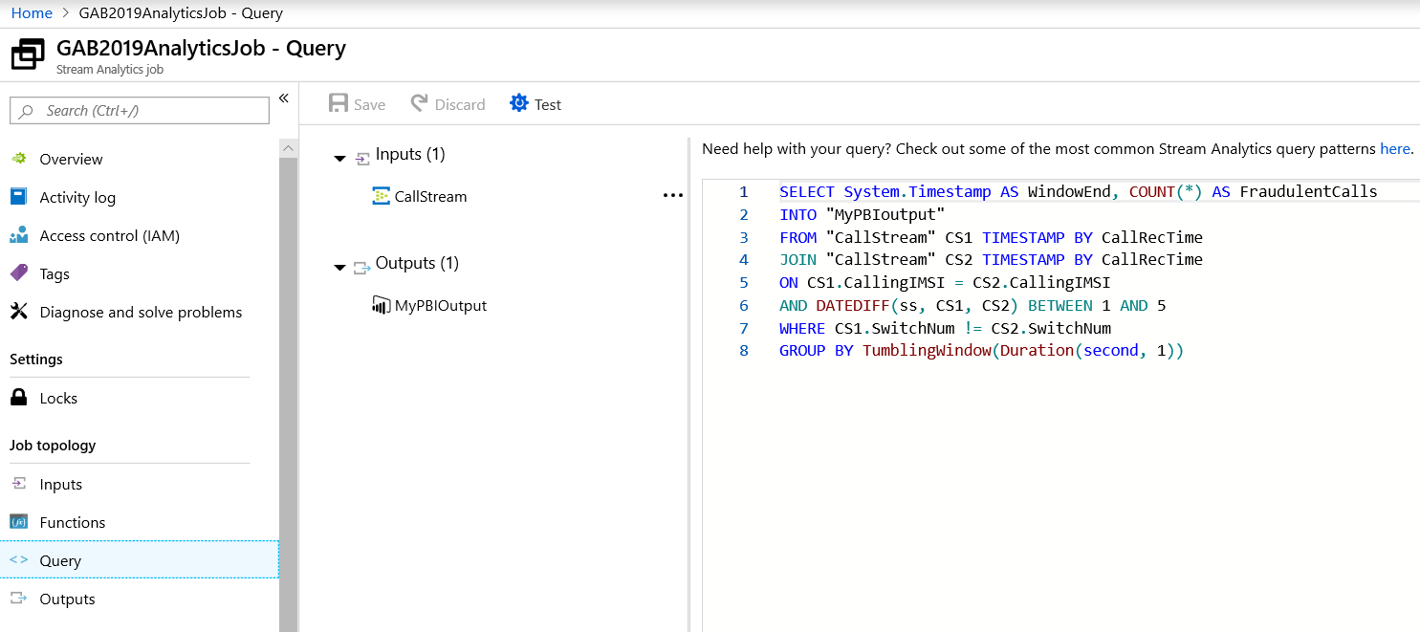
Stream Analytics Job - Query

Slide 13
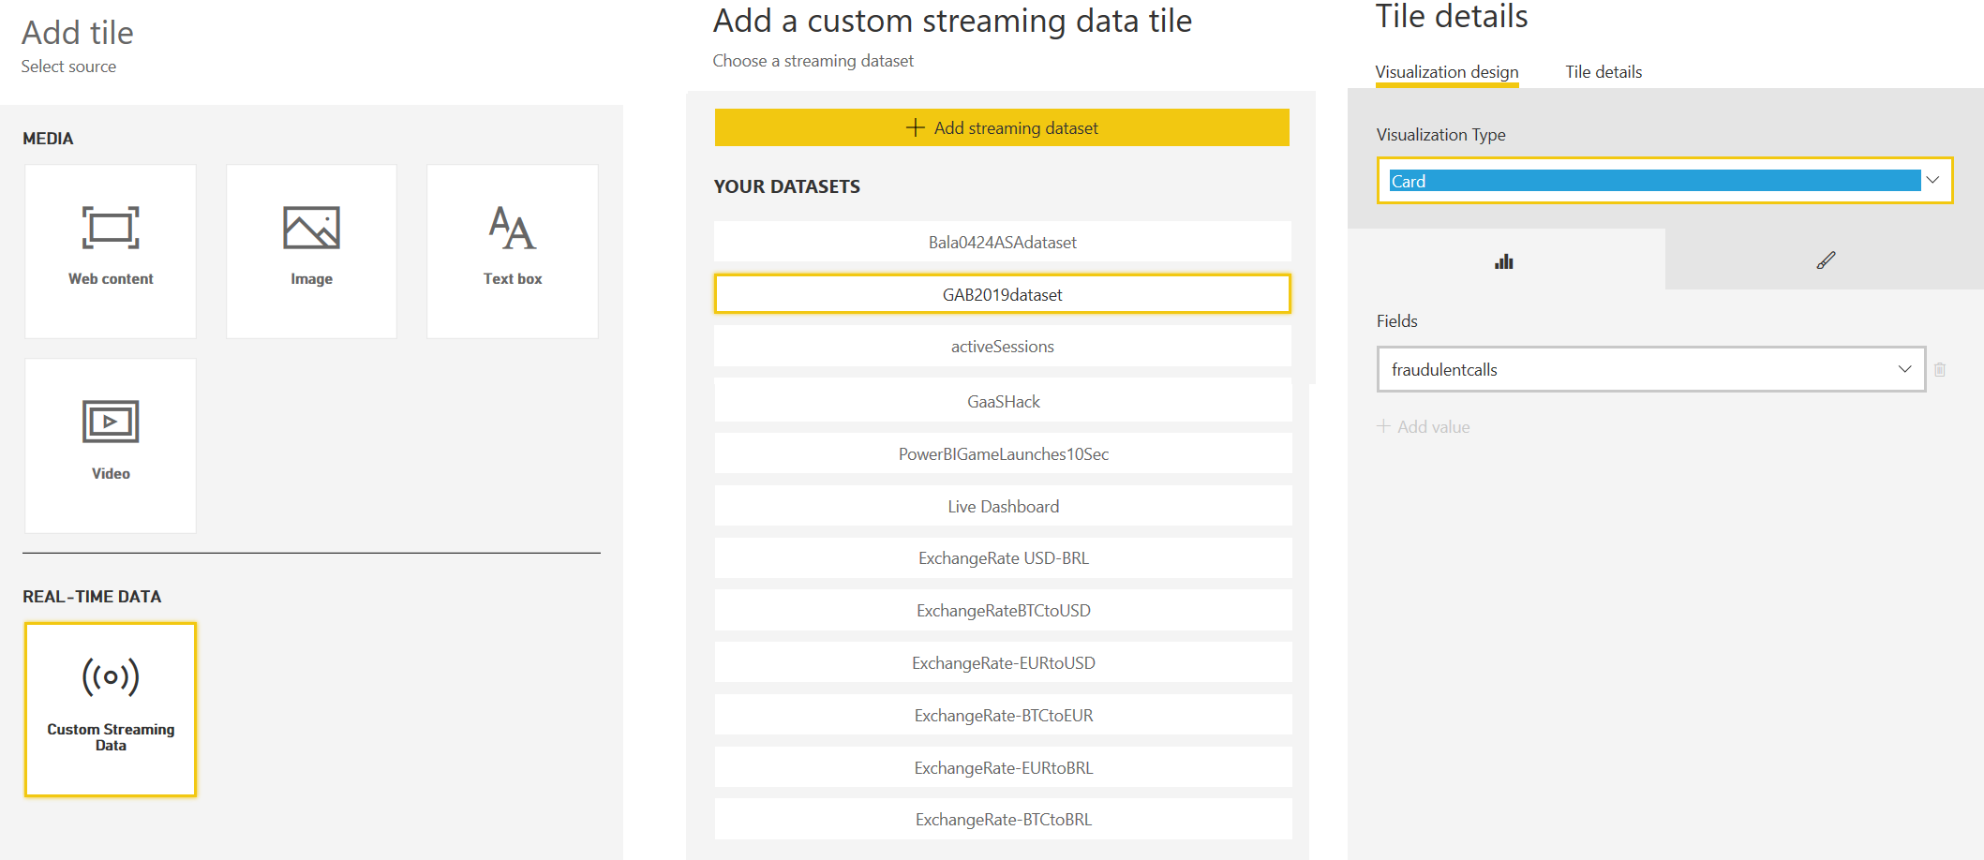
Visualize in Power BI

Slide 14
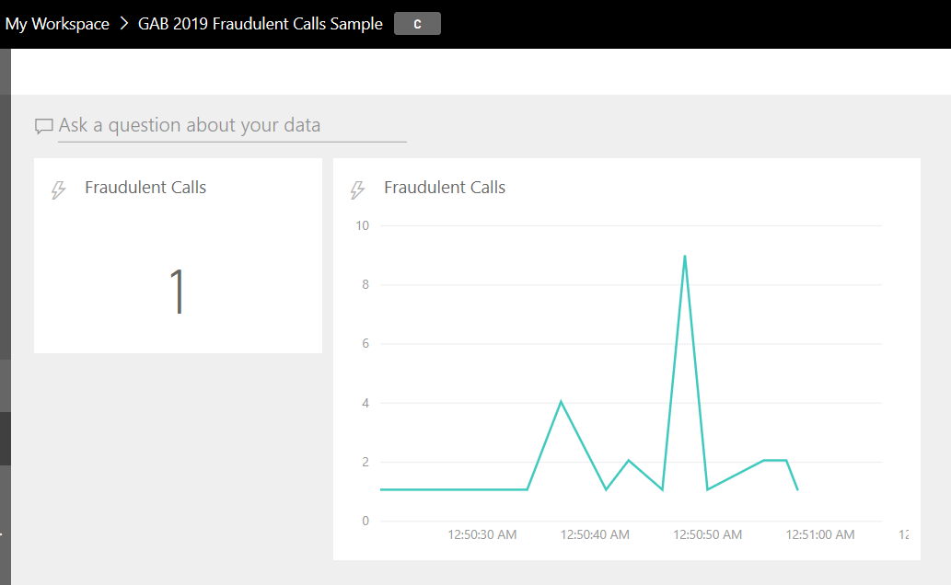
Visualize in Power BI

Slide 15


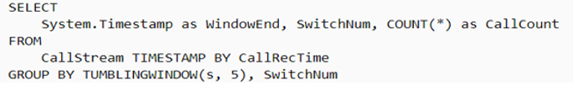
Stream Analytics – Query is the main part
Pass-through query
Reduce the number of fields using a column projection
Count incoming calls by region: Tumbling window with aggregation

Slide 16
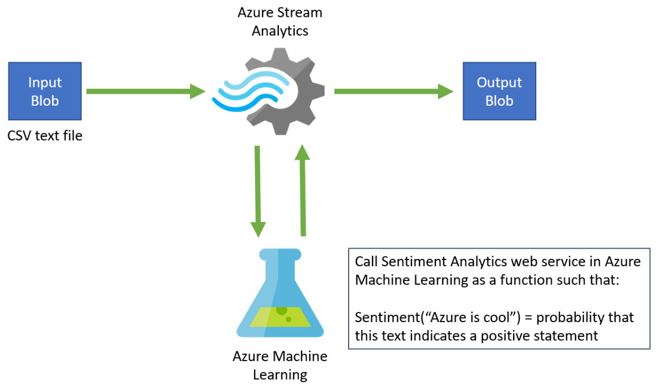
Stream Analytics and Machine Learning
Analyzing real-time sentiment on Twitter feed data

Slide 17
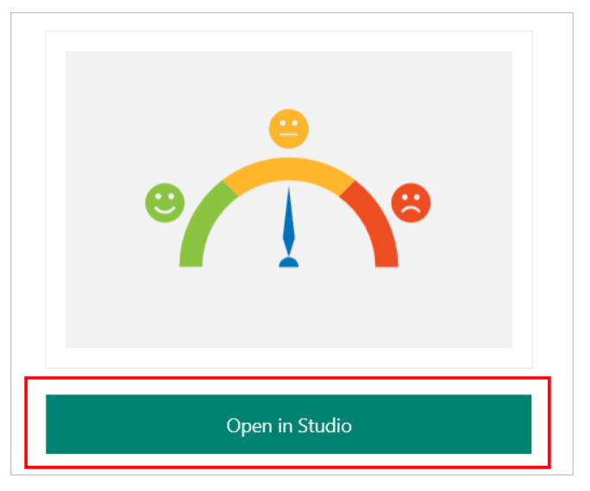
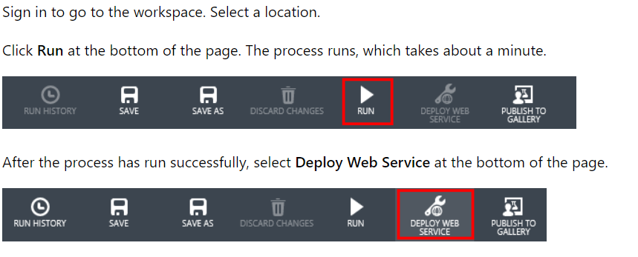
Add sentiment analytics model
Add sentiment analytics model from Cortana Intelligence Gallery
Deploy as a web service in Azure, it will give you Web Service URL and API Key

Slide 18
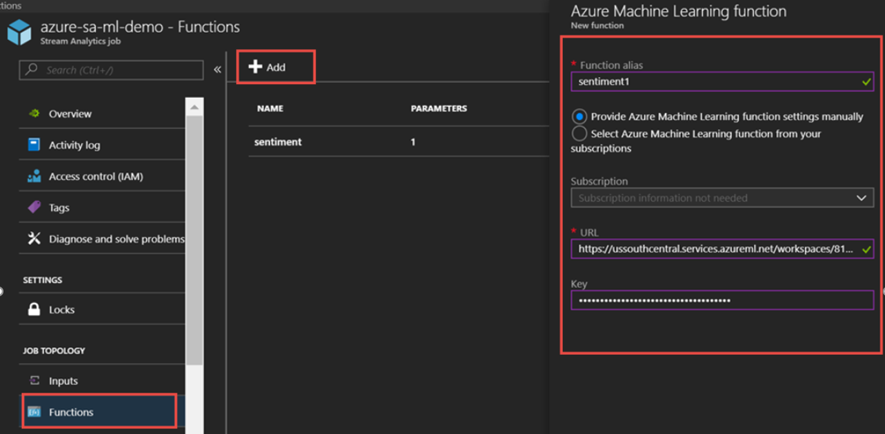
Create a Stream Analytics job
Configure input : Blob storage (csv sample) or real Twitter feed
Configure output : Blob storage (csv)
Add Machine Learning function : sentiment1. Use the web service URL from earlier

Slide 19
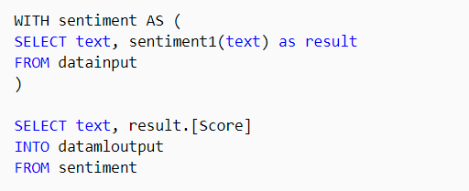
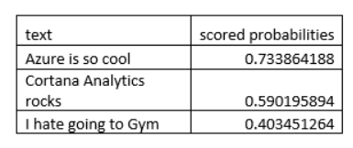
Create the query and start the job
Output

Slide 20
Anomaly Detection
Azure Stream Analytics offers built-in machine learning based anomaly detection capabilities
Can be used to monitor the two most commonly occurring anomalies: temporary and persistent.
AnomalyDetection_SpikeAndDip and AnomalyDetection_ChangePoint functions : Machine Learning based operators built-in to Stream Analytics

Slide 21
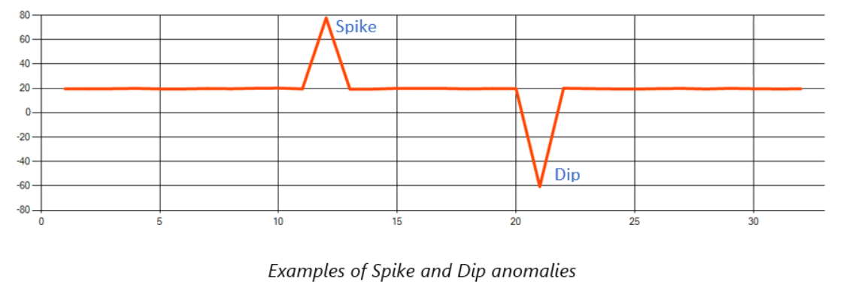
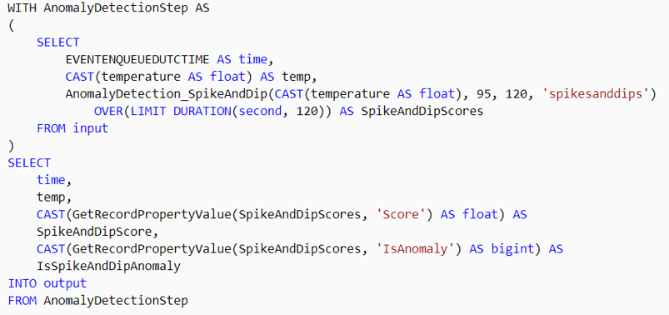
AnomalyDetection_SpikeAndDip

Slide 22
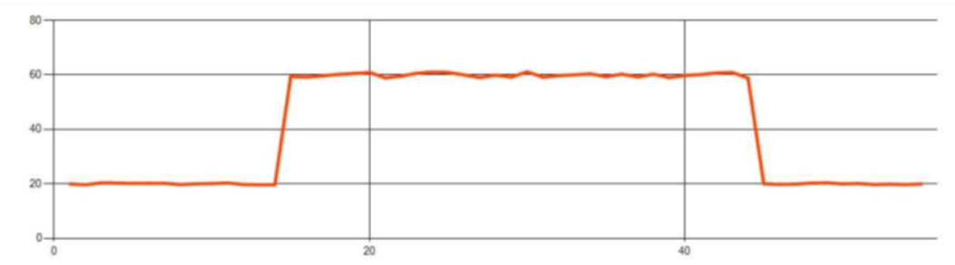
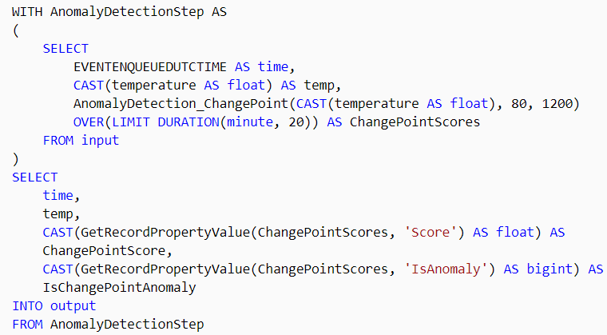
AnomalyDetection_ChangePoint

Slide 23
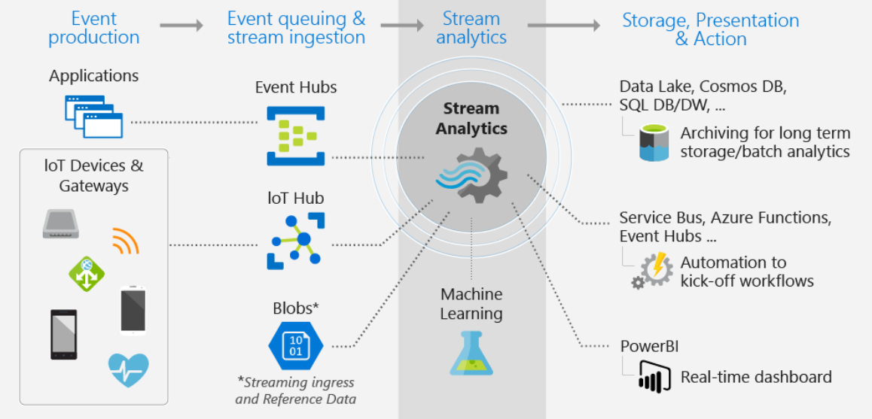
Summary

Slide 24
Thank you.
Bala Chirtsabesan
Software Engineer, Microsoft
@balachir
gab@gab.com
gabch.com
@gabchennai

